Slide 1
Chapter 13: Data Storage Structures

Slide 2
Outline
File Organization
  Fixed-Length Records
  Variable-Length Records
Organization of Records in Files
  Heap File Organization
  Sequential File Organization
  Multitable Clustering File Organization
  Table Partition
Data-Dictionary Storage
Storage Access & Buffer manager
  LRU strategy
  Clock algorithm
Columnar Representation

Slide 3
File Organization
The database is stored as a collection of files.
Each file is a sequence of records.
A record is a sequence of fields.
One approach:
  assume record size is fixed
  each file has records of one particular type only
  different files are used for different relations
This case is easiest to implement; will consider variable length records later.
We assume that records are smaller than a disk block
  .

Slide 4
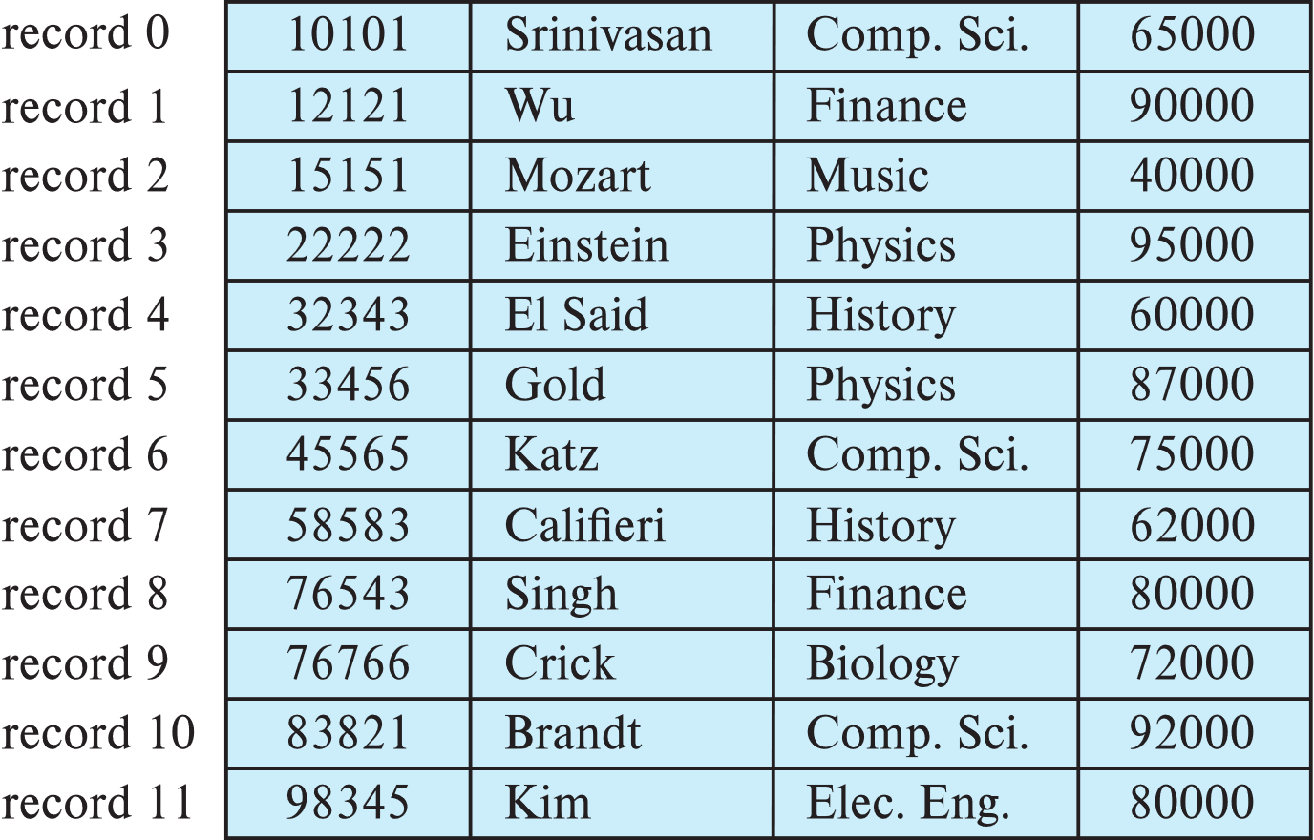
Fixed-Length Records
Simple approach:
  Store record i starting from byte n ∗ (i – 1), where n is the size of each record.
  Record access is simple but records may cross blocks
    Modification: do not allow records to cross block boundaries

Slide 5
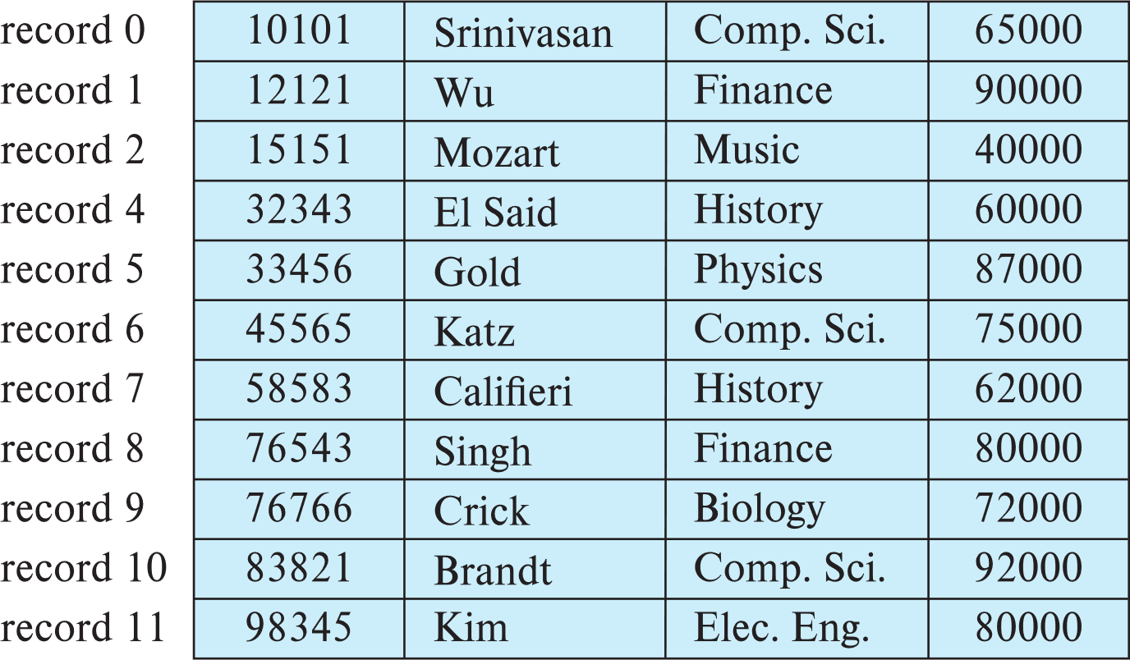
Fixed-Length Records
Deletion of record i: alternatives:
  move records i + 1, . . ., n to i, . . . , n – 1
  move record n to i
  do not move records, but link all free records on a free list
  Record 3 deleted

Slide 6
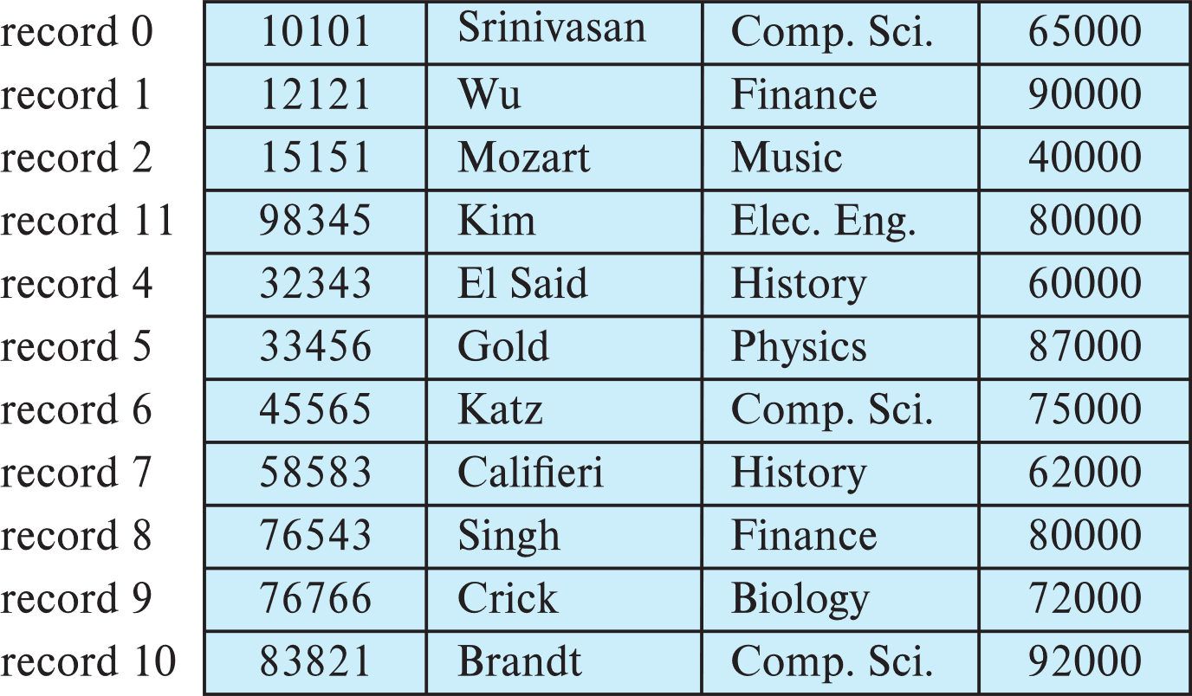
Fixed-Length Records
Deletion of record i: alternatives:
  move records i + 1, . . ., n to i, . . . , n – 1
  move record n to i
  do not move records, but link all free records on a free list
  Record 3 deleted and replaced by record 11

Slide 7
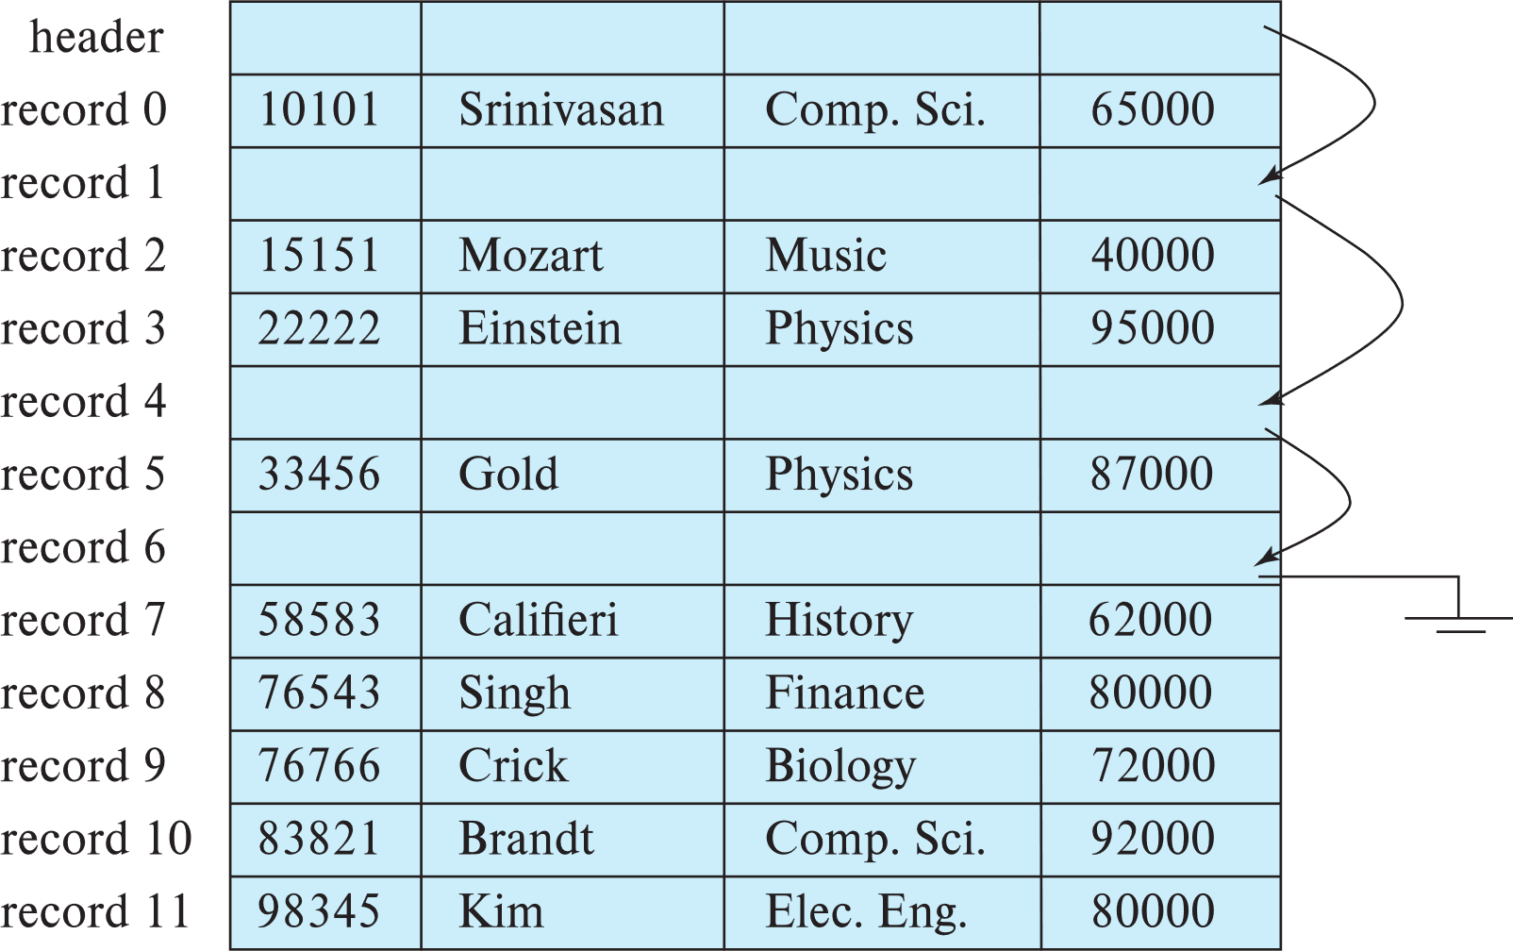
Fixed-Length Records
Deletion of record i: alternatives:
  move records i + 1, . . ., n to i, . . . , n – 1
  move record n to i
  do not move records, but link all free records on a free list

Slide 8

Variable-Length Records
Variable-length records arise in database systems in several ways:
  Storage of multiple record types in a file.
  Record types that allow variable lengths for one or more fields such as strings (varchar)
  Record types that allow repeating fields (used in some older data models).
Attributes are stored in order
Variable length attributes represented by fixed size (offset, length), with actual data stored after all fixed length attributes
Null values represented by null-value bitmap（空位图）
Instructor（id，name, dept_name, salary)

Slide 9

Variable-Length Records: Slotted Page Structure
Slotted page（分槽页） header contains:
  number of record entries
  end of free space in the block
  location and size of each record
Records can be moved around within a page to keep them contiguous with no empty space between them; entry in the header must be updated.
Record pointers should not point directly to record — instead they should point to the entry for the record in header.

Slide 10
Organization of Records in Files
Heap – record can be placed anywhere in the file where there is space
Sequential – store records in sequential order, based on the value of the search key of each record
In a multitable clustering file organization records of several different relations can be stored in the same file
  Motivation: store related records on the same block to minimize I/O
B+-tree file organization
  Ordered storage even with inserts/deletes
Hashing – a hash function computed on search key; the result specifies in which block of the file the record should be placed

Slide 11
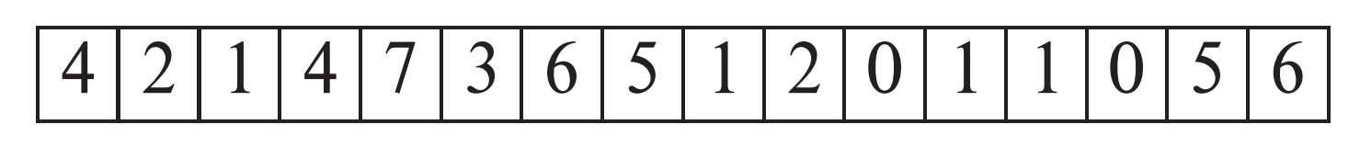
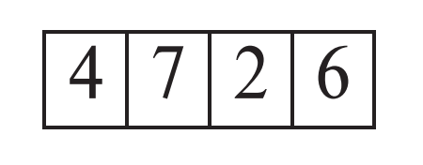
Heap File Organization
Records can be placed anywhere in the file where there is free space
Records usually do not move once allocated
Important to be able to efficiently find free space within file
Free-space map
  Array with 1 entry per block. Each entry is a few bits to a byte, and records fraction of block that is free
  In example below, 3 bits per block, value divided by 8 indicates fraction of block that is free
  Can have second-level free-space map
  In example above, each entry stores maximum from 4 entries of first-level free-space map
Free space map written to disk periodically, OK to have wrong (old) values for some entries (will be detected and fixed)
first level
second level

Slide 12

Sequential File Organization
Suitable for applications that require sequential processing of the entire file
The records in the file are ordered by a search-key

Slide 13

Sequential File Organization (Cont.)
Deletion – use pointer chains
Insertion –locate the position where the record is to be inserted
  if there is free space insert there
  if no free space, insert the record in an overflow block
  In either case, pointer chain must be updated
Need to reorganize the file
from time to time to restore
sequential order

Slide 14



Multitable Clustering File Organization
Store several relations in one file using a multitable clustering file organization
department
instructor
multitable clustering
of department and
instructor

Slide 15

Multitable Clustering File Organization (cont.)
good for queries involving join department instructor, and for queries involving one single department and its instructors
bad for queries involving only department
results in variable size records
Can add pointer chains to link records of a particular relation

Slide 16
Table Partitioning
Table partitioning: Records in a relation can be partitioned into smaller relations that are stored separately
E.g., transaction relation may be partitioned into
transaction_2018, transaction_2019, etc.
Queries written on transaction must access records in all partitions
  Unless query has a selection such as year=2019, in which case only one partition in needed
Partitioning
  Reduces costs of some operations such as free space management
  Allows different partitions to be stored on different storage devices
    E.g., transaction partition for current year on SSD, for older years on magnetic disk

Slide 17
Data Dictionary Storage
The Data dictionary (also called system catalog) stores metadata; that is, data about data, such as
Information about relations
  names of relations
  names, types and lengths of attributes of each relation
  names and definitions of views
  integrity constraints
User and accounting information, including passwords
Statistical and descriptive data
  number of tuples in each relation
Physical file organization information
  How relation is stored (sequential/hash/…)
  Physical location of relation
Information about indices

Slide 18

Relational Representation of System Metadata
Relational representation on disk
Specialized data structures designed for efficient access, in memory

Slide 19
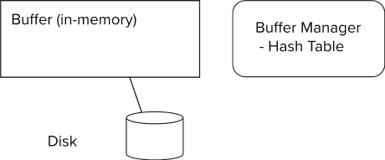
Storage Access
Blocks are units of both storage allocation and data transfer.
Database system seeks to minimize the number of block transfers between the disk and memory. We can reduce the number of disk accesses by keeping as many blocks as possible in main memory.
Buffer – portion of main memory available to store copies of disk blocks.
Buffer manager – subsystem responsible for allocating buffer space in main memory.

Slide 20
Buffer Manager in DBMS
Higher Level Access
Buffer
Main Memory
Database
Disk

Slide 21
LRU Example
Supposing there are 4 buffer pages.
Initial is empty occupied。
The access sequence is 1, 4, 8, 1, 5, 2, 3, 2, 4.
According to the LRU policy , there are 3 times replacement occurred.
Access
1 4 8 1 5 2 3 2 4
5
2
3
2
4
Buffer
8
1
1
5
2
3
2
4
4
8
8
1
5
5
3
1
1
1
4
4
8
1
1
5

Slide 22
Buffer Manager
Programs call on the buffer manager when they need a block from disk.
  If the block is already in the buffer, buffer manager returns the address of the block in main memory
  If the block is not in the buffer, the buffer manager
    Allocates space in the buffer for the block
      Replacing (throwing out) some other block, if required, to make space for the new block.
      Replaced block written back to disk only if it was modified since the most recent time that it was written to/fetched from the disk.
    Reads the block from the disk to the buffer, and returns the address of the block in main memory to requester.

Slide 23
Buffer Manager
Buffer replacement strategy (details coming up!)
Pinned block: memory block that is not allowed to be written back to disk
  Pin done before reading/writing data from a block
  Unpin done when read /write is complete
  Multiple concurrent pin/unpin operations possible
    Keep a pin count, buffer block can be evicted only if pin count = 0
Shared and exclusive locks on buffer
  Needed to prevent concurrent operations from reading page contents as they are moved/reorganized, and to ensure only one move/reorganize at a time
  Readers get shared lock, updates to a block require exclusive lock
  Locking rules:
    Only one process can get exclusive lock at a time
    Shared lock cannot be concurrently with exclusive lock
    Multiple processes may be given shared lock concurrently

Slide 24
Buffer-Replacement Policies
LRU strategy - replace the block least recently used .
  Idea behind LRU – use past pattern of block references as a predictor of future references
Queries have well-defined access patterns (such as sequential scans), and a database system can use the information in a user’s query to predict future references
  LRU can be a bad strategy for certain access patterns involving repeated scans of data
  For example: when computing the join of 2 relations r and s by a nested loops
  for each tuple tr of r do
  for each tuple ts of s do
  if the tuples tr and ts match …
Mixed strategy with hints on replacement strategy provided
by the query optimizer is preferable

Slide 25
Buffer-Replacement Policies (Cont.)
Toss-immediate strategy – frees the space occupied by a block as soon as the final tuple of that block has been processed
Most recently used (MRU) strategy – system must pin the block currently being processed. After the final tuple of that block has been processed, the block is unpinned, and it becomes the most recently used block.
Buffer managers also support forced output of blocks for the purpose of recovery

Slide 26
Clock: An approximation of LRU
Arrange block into a cycle, store one reference_bit per block
When pin_count reduces to 0, set reference _bit =1
reference _bit as the 2nd chance bit
0
1
1
0
1
1
1
0

Slide 27
Clock: An approximation of LRU
When replacement necessary
do for each block in cycle {
if (reference_bit ==1)
set reference_bit=0;
else if (reference_bit ==0)
choose this block for replacement;
} until a page is chosen;
0
1
0
0
0
1
0
0

Slide 28
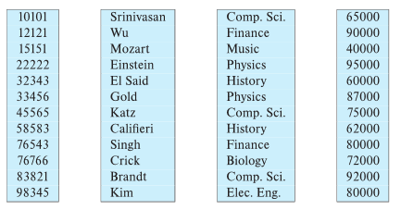
Column-Oriented Storage
Also known as columnar representation
Store each attribute of a relation separately
Example

Slide 29
Columnar Representation
Benefits:
  Reduced IO if only some attributes are accessed
  Improved CPU cache performance
  Improved compression
  Vector processing on modern CPU architectures
Drawbacks
  Cost of tuple reconstruction from columnar representation
  Cost of tuple deletion and update
  Cost of decompression
Columnar representation found to be more efficient for decision support than row-oriented representation
Traditional row-oriented representation preferable for transaction processing
Some databases support both representations
  Called hybrid row/column stores

Slide 30
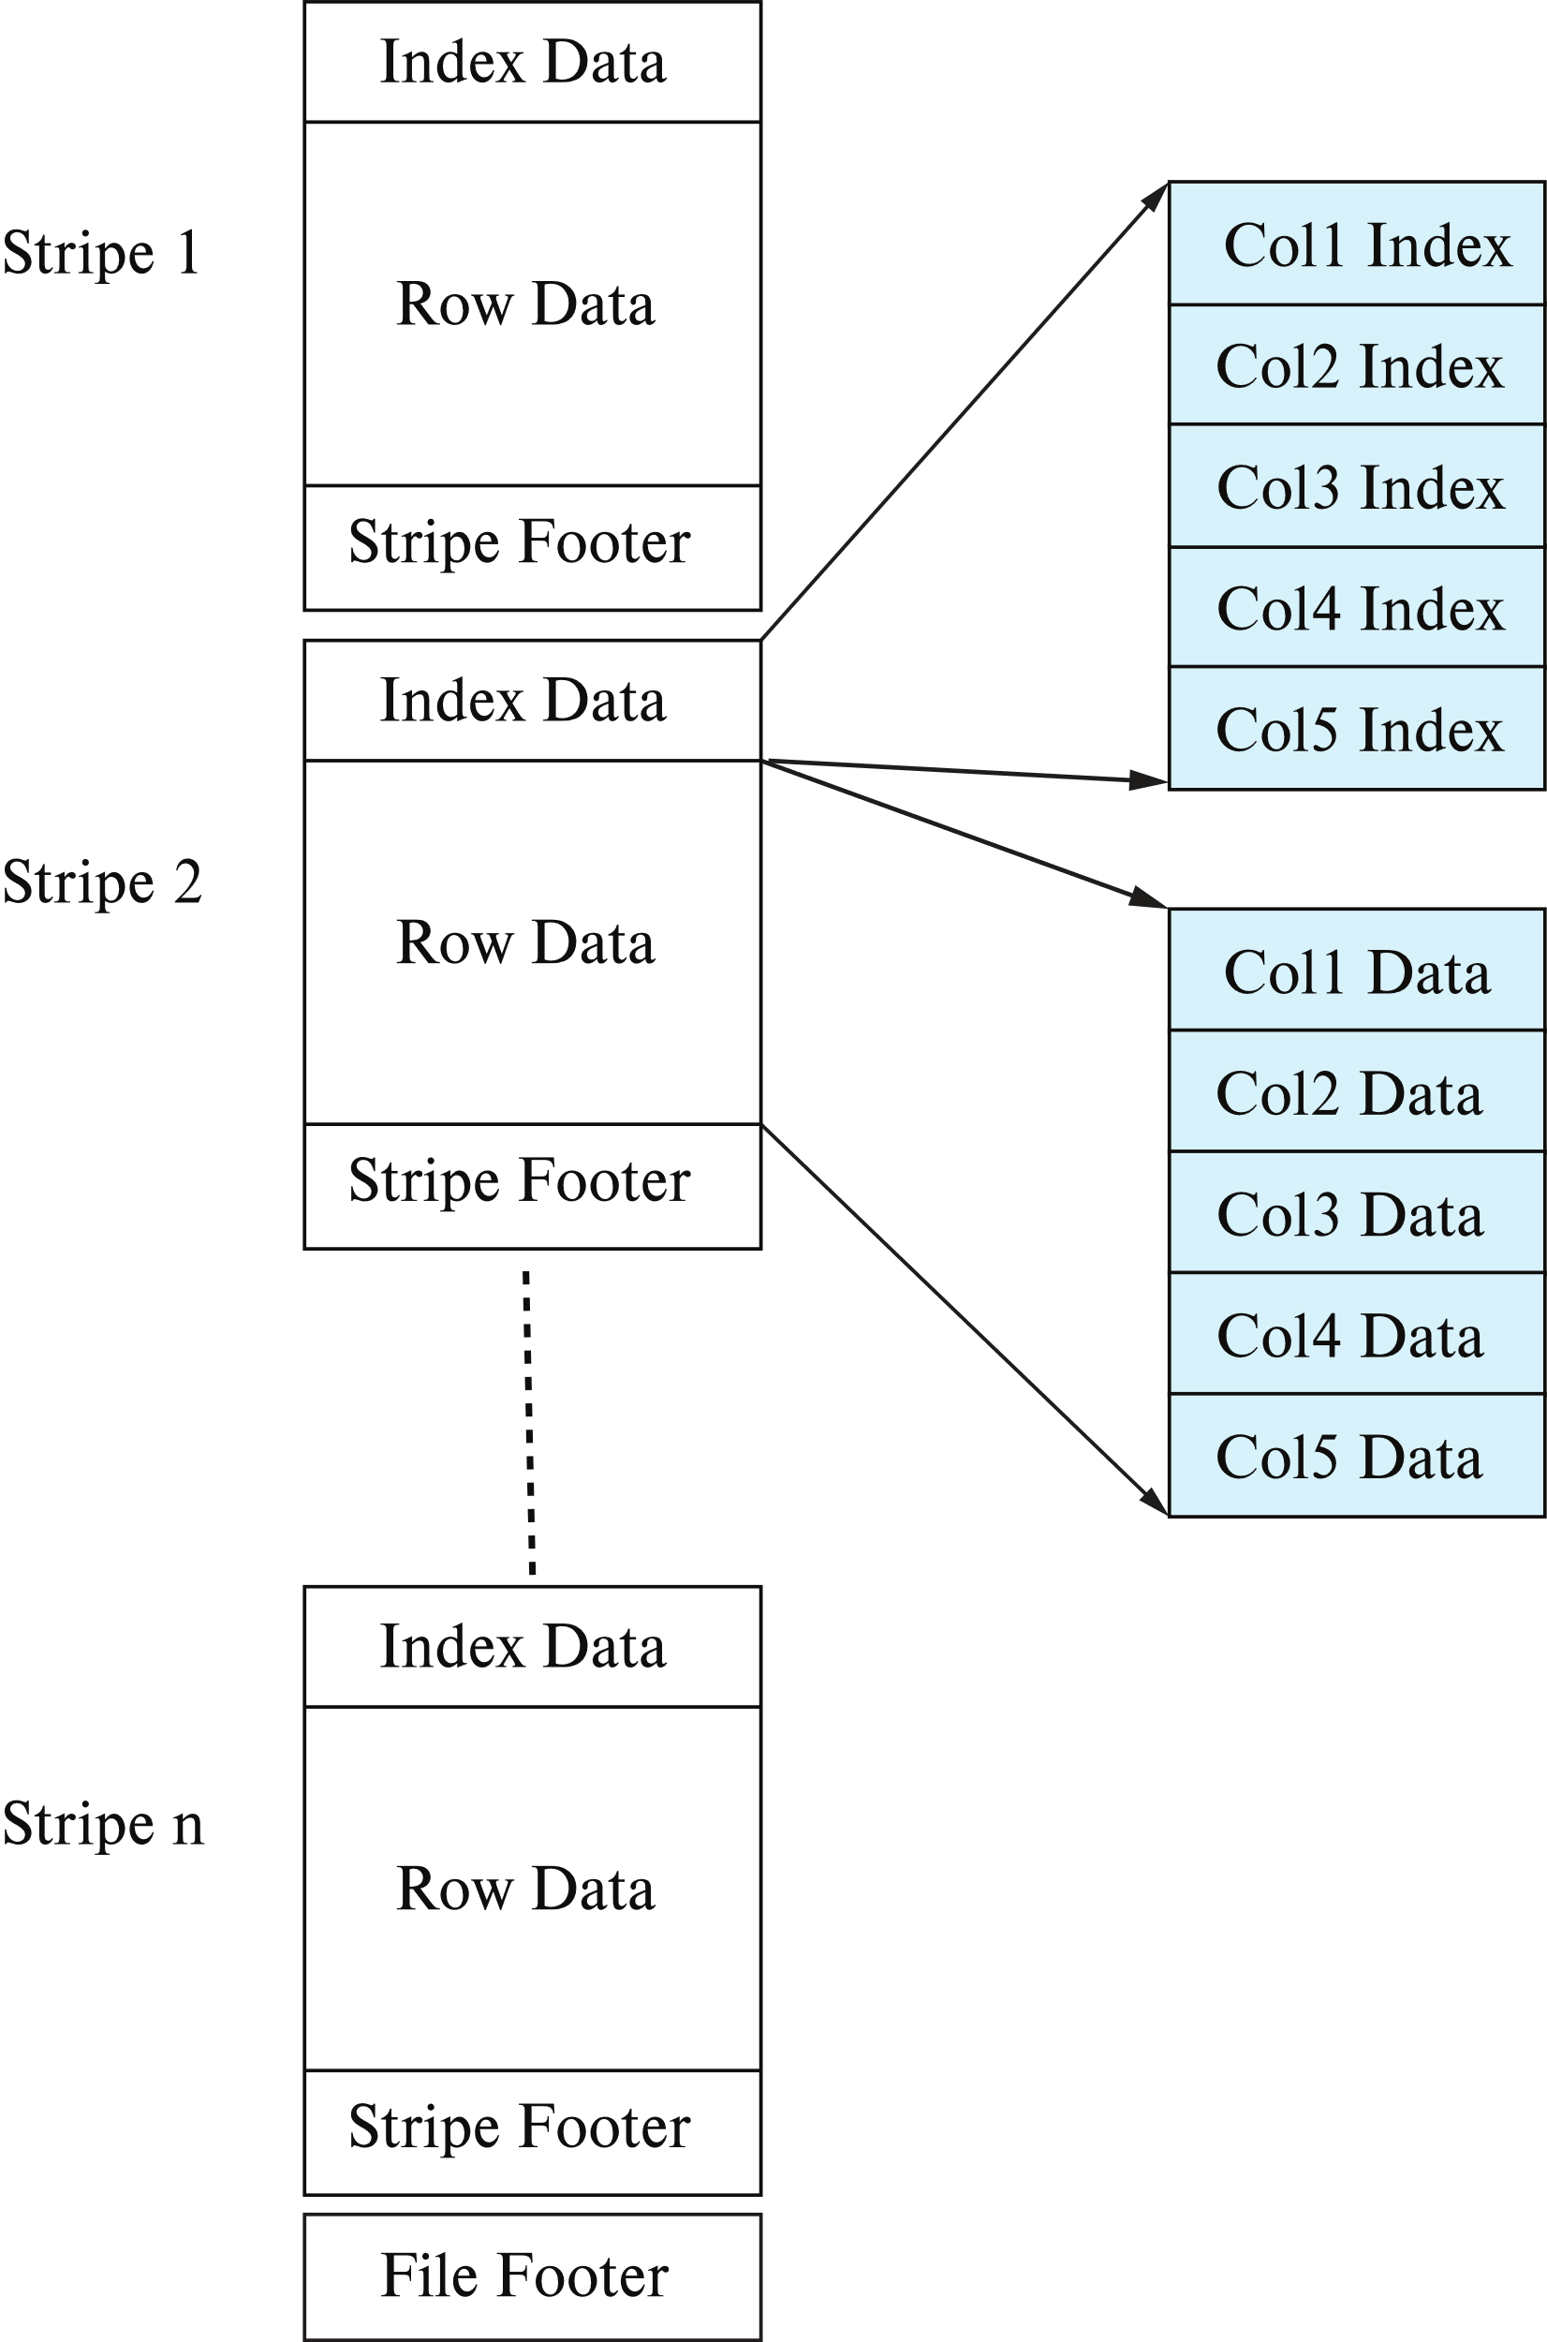
Columnar File Representation
ORC(Optimized Row Columnar) and Parquet
  File formats of Hadoop HDFS
  Apache ORC is an open source, aself-describing type-aware columnar file format designed for Hadoop workloads.
  Apache Parquet is an open source, column-oriented data file format designed for efficient data storage and retrieval.
  File formats with columnar storage inside file
  Very popular for big-data applications
Orc file format shown on right:

Slide 31
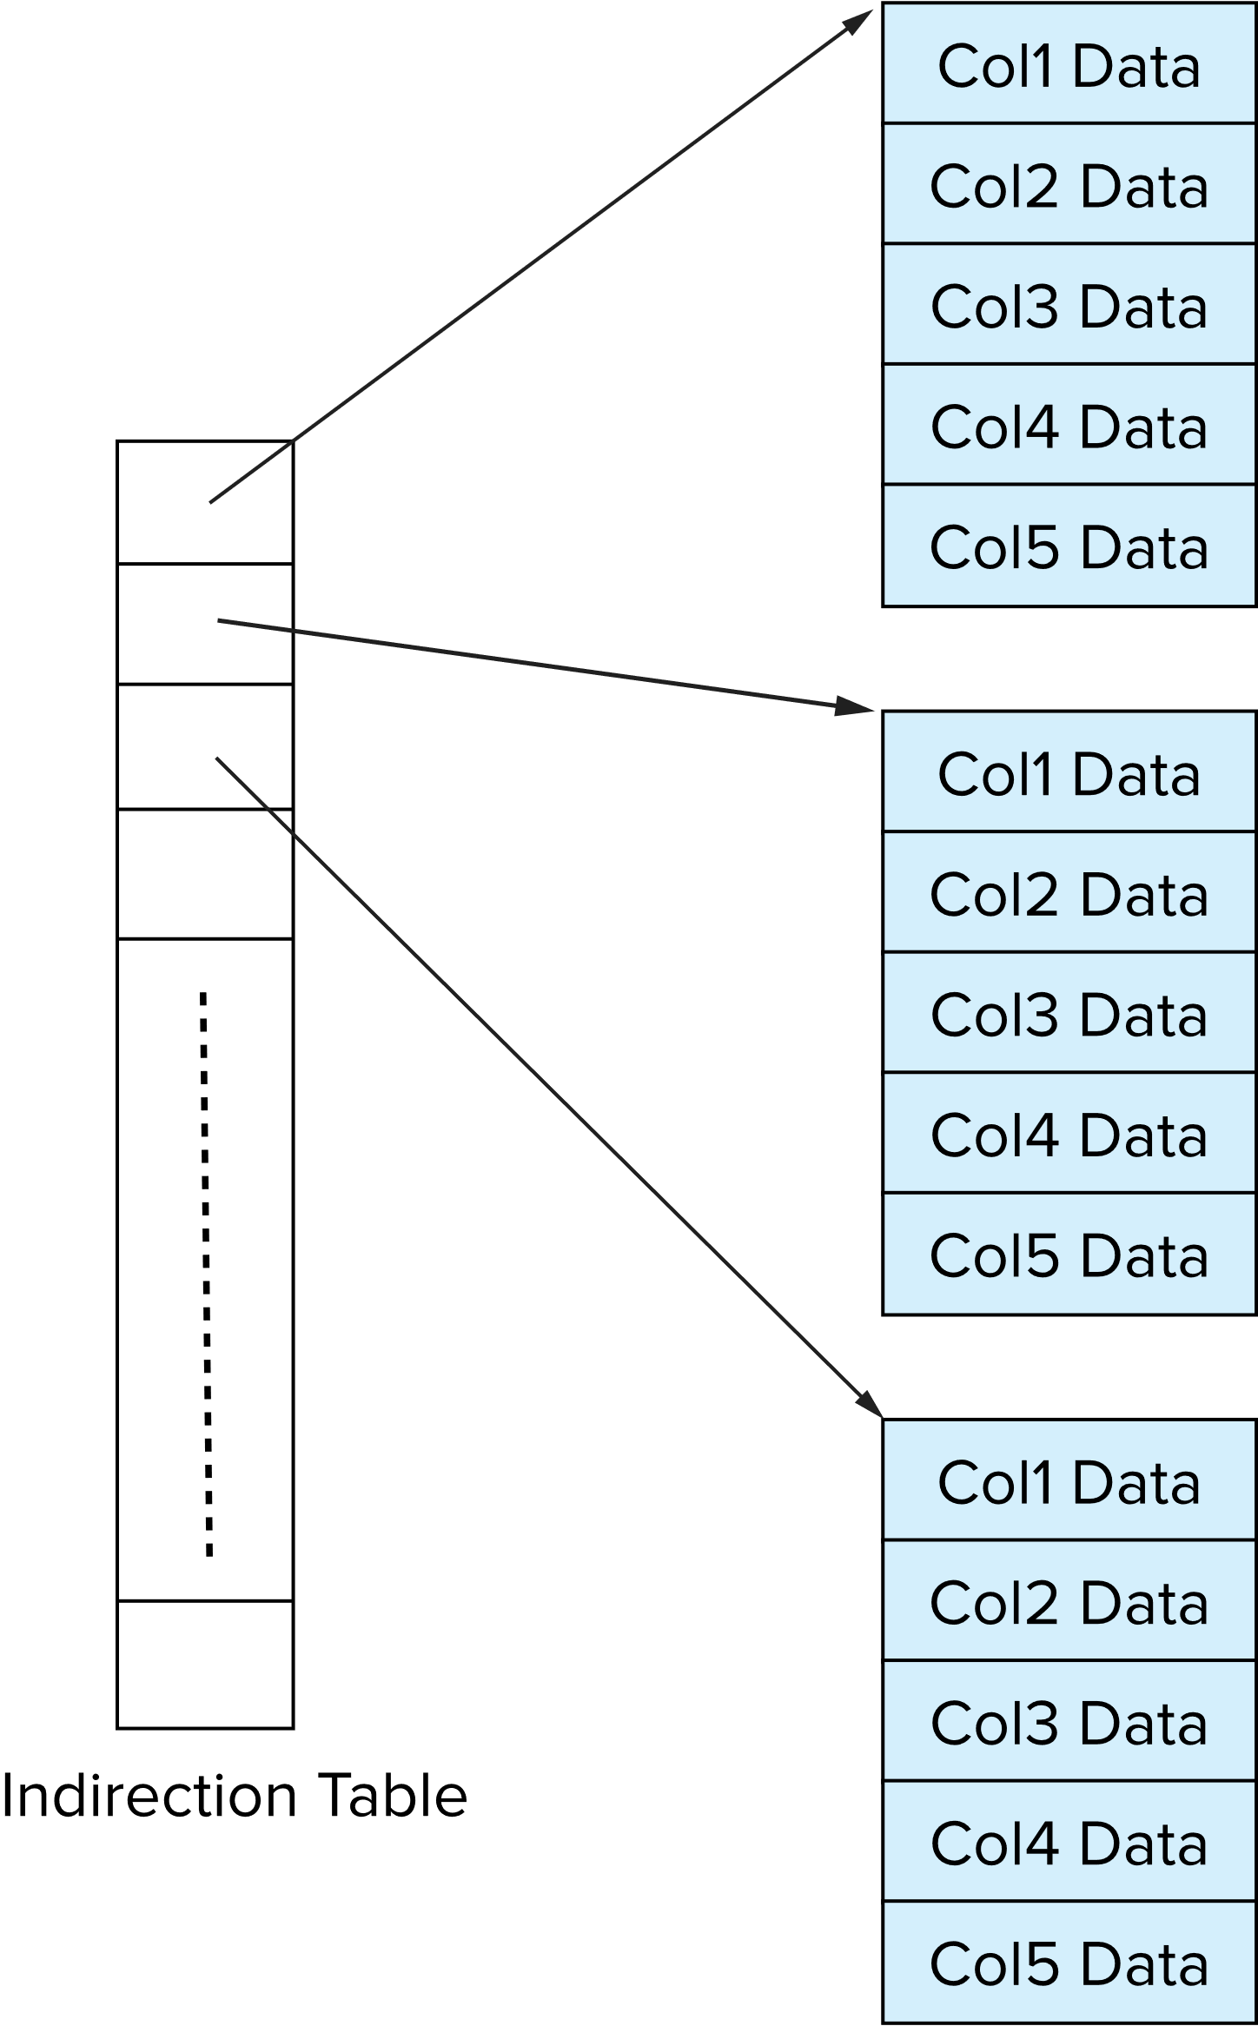
Storage Organization in Main-Memory Databases
Can store records directly in memory without a buffer manager
Column-oriented storage can be used in-memory for decision support applications
  Compression reduces memory requirement

Slide 32
End of Chapter 13

